Slide 1
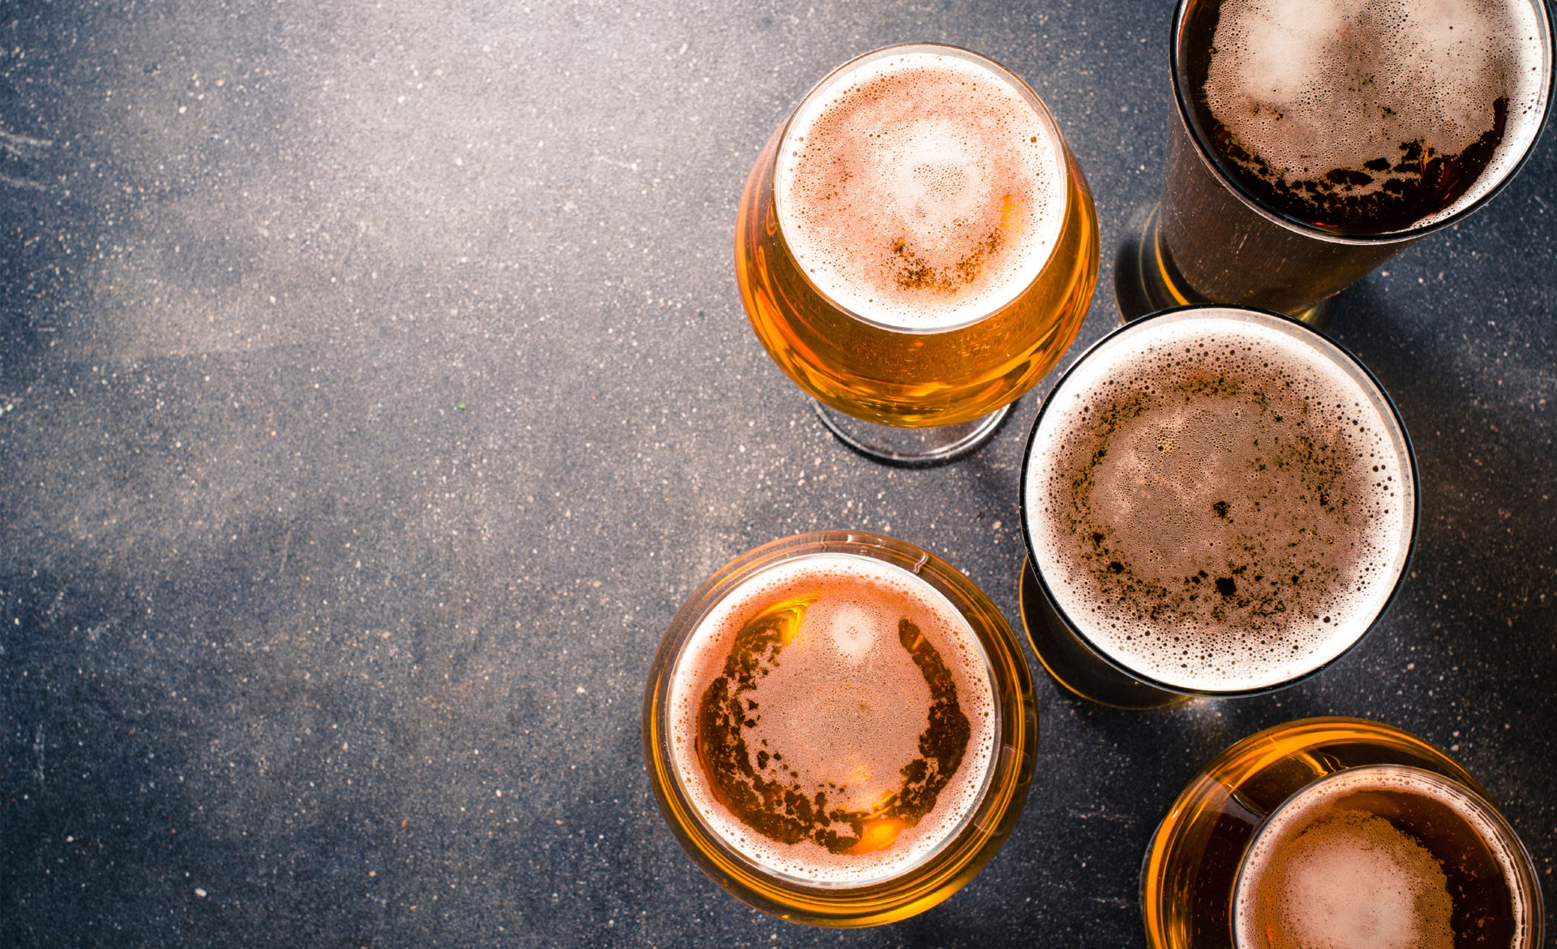

Predictive Pandas presents
Michelle Hocking
Eamonn McCallum
Pooja Mallard
Ruohong Yuan
Yann Chye
Katherine Shamai

Slide 2


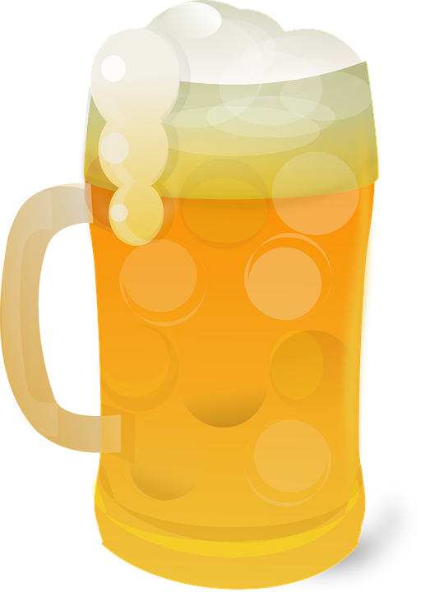
Getting back on the beers
Now that Victorians can “get on the beers” again, what to drink?
You can go with the same old, same old but you’re probably tired of that since that’s all you’ve been drinking for the past 6 months
We thought it would be great to celebrate the world of craft beers and get beer lovers to try something different and find a new favorite
Using review data and data on breweries, we set out on a virtual brewery crawl to find good datasets and ways to teach a model how to appreciate a good craft beer, and recommend one
The oldest brewery dates back to 1040
Notes:
China is the world’s biggest beer producer with over 47 million kiloliters per year
The Czech Republic consumed 2,033 million liters of beer in 2018
McDonald’s sells beer on its menu in many countries such as France, Germany, Portugal, and South Korea
‘Snake Venom’ is the strongest beer in the world with 67.5% alcohol by volume
China consumes the most beer as a whole
Every year, the US generates profits of over 100 billion dollars from beer alone
The Pilsner’s name came from the Czech city of Pilsen (Plzeň)
Craft beer is more prized than commercial beer
Drinking stout could help fight cancer
Storing any kind of beer above 12° C will deteriorate its flavor and quality
There are several beer spas in the Czech Republic
Barack Obama brewed his own beer at the White House
Drinking beer reduces the risk of kidney stones
Beer can also lower the risk of coronary heart disease
Drinking beer significantly lowers the risk of developing type 2 diabetes
Drinking beer increases good cholesterol
Beer drinkers are better thinkers at old age

Slide 3

Data points
From our search, we identified 3 data points which provided us with the information needed
Data point 1 – Dataworld
Data point 2 – BeerAdvocate Website
Data point 3 – Google API
China is the world’s biggest beer producer with over 47 million kiloliters per year

Slide 4
Data Munging
Data extraction
Data transformation
Exploratory anslysis
Visualising the data
Data aggregation
Adding features
Machine learning
Training the model
Web app

Slide 5
ETL
Cleansing of data included adding feature for each unique beer and grouping reviews by beer
Count of review and understanding the standard deviation to determine the reliability and variability of the reviews
Notes:
** Started with a DataWorld dataset
** the stats - 1.5m reviews, 5k breweries and 16k unique beers
** 13 fields, broken down into:
2 identifiers (brewery and beer) each with a descriptor
5 review scores for different ‘features’ of a beer + it’s alcohol content (abv)
a time stamp and the profilename of the reviewer
** Dataset relatively ‘clean’ so focus shifted quickly to data profiling
** Validated high alcohol content beers which appeared to be outliers initially
** Investigated high correlation in 5 review scores and discovered dataset skewed to the right - showing tendency to rate between 3-5
** Looked for bias in profilenames and timing of reviews
** Made decision to leave in/out reviews????
** As profiling evolved began to look for additional features to add in

Slide 6
Scraping for brewery data
Notes:
** First stop (as always!) lat/lon - mapping feature - combination of Beer Advocate (source website) and google maps
** also ‘finessed’ the beer style values in the dataset, with a large number of ‘unique’ styles in the data, creating a new aggregator (from 104 to 11 styles)
** observed number of retired beers whilst working with the dataset. Field also included seasonal/annual availability so decided to add as a feature as well as quantify and decide whether to exclude
** words (sentiment analysis) - scraping reviewer sentiment including words (“start words”) rather than using stop words (used 173 in total) from beer sommelier tasting guides

Slide 7
Machine Learning

Slide 8
Training the model

Slide 9
Visualisation

Slide 10
Streamlit

Slide 11
Interesting observations

Slide 12
Challenges

Slide 13
If I had my time again

Slide 14
Other features we would add
Seek feedback from users on our recommendation to enable further refinement of the machine learning model
Provide reviewing capabilities to grow the dataset for machine learning

Slide 15
Demo

